Slide 1

Algebra of Systems (AoS) as a Meta Language
Theory and Practice of how to Algebraically generate System Solutions
Image credit: NFTs Will Be Key to Accessing the Metaverse—And Beyond by Shreyansh Singh
Ben Koo
2021-11-16
Security Level:

Slide 2
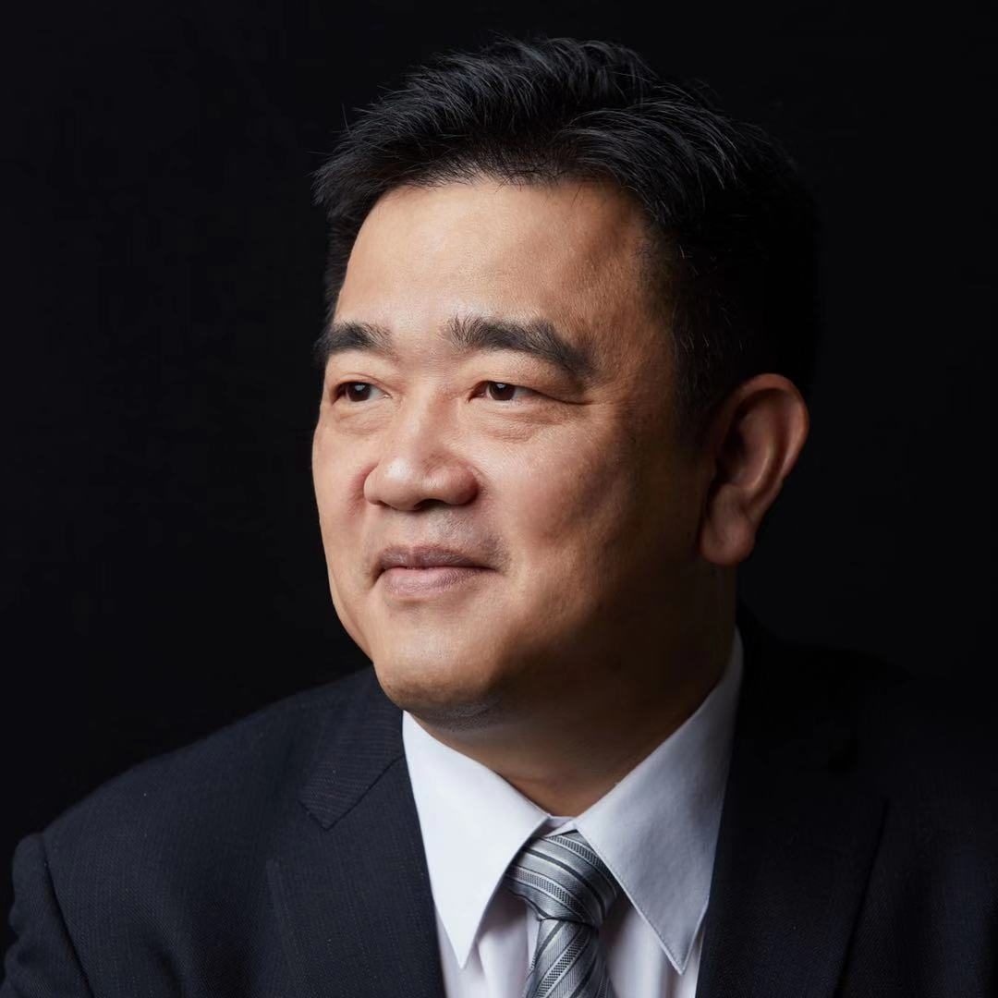
Bio
Benjamin Koo (顧學雍)
Inventor of Algebra of Systems （AoS）
Surya University, Vice President of Research and Development
Ph. D. in Engineering Systems, MIT
Masters in Systems Management and Design，MIT
Masters in Industrial Engineering. University of Minnesota
Bachelor in Mechanical Engineering, University of Minnesota
Technology Strategy Advisor to Minister Luhut Panjadang
Email: koo0905@gmail.com
Personal Homepage：http://xlp.pub

Slide 3



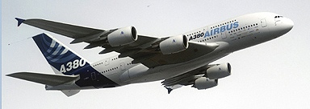

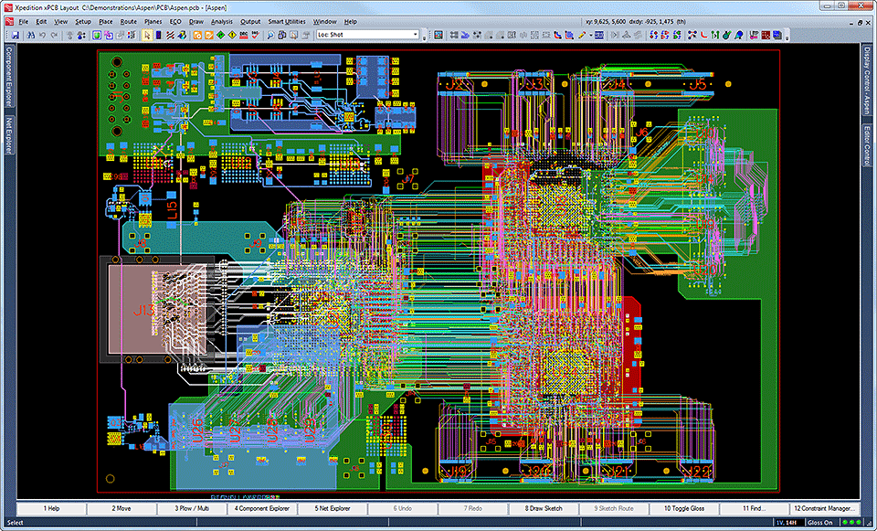
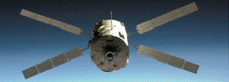
System Design requires knowledge that are Inter-Disciplinary、Multi-Scale in nature
System Specifications and Design Solutions must be
expressed in the format/semantics for various domains of stakeholders
Electronic Design Automation (EDA)
Artificial Intelligence
Machine Learning
Real time System Model Verification
The Design Automation of
Large Scale Integrated Circuit Chips
and the circuit board
(The Chips and Circuit Boards are two different levels)
Source Code Generation could
come from a Large Set of Prior Data
(Data and Code are two different levels)
Abstract Interpretation and
source code semantic analysis
(System control takes place at different levels)
Notes:
(notes) add hyperlinks with definitions
Soundness: A Sound statement is a true statement whose composed sub-statements all accountably true, and the overall constructed statement also can be assessed to be true.
The degree of a statement to be sound is its Soundness assessment.
Precision (The result has a outer boundary)
Termination (It will come to completion)

Slide 4







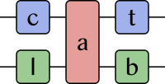
Decision Support Mechanisms are scattered across many models of computation
AoS
 | Algebra of Systems | Discrete Model | System Dynamics | Probability Reasoning | Expert Rules | Category Theory | Proof Assistants
Operands (Noun phrases) | <P, B, C> | Event Tokens | Variable Matrices | Probability Distribution Functions of Variables | Boolean variables | Objects | Propositional Statements
Operator（Verb Phrases） | {encd, enum, eval} | Token Transformations | Time-based Evolution Operator | Conditional Probability Distribution Matrices | Logical Rules | Morphisms | User Guidance
Expression of Relations | Kev-Value Pairs | Topological Relations | Variable Dependency Expression | Causal Dependency Structures | Assumptions and Assertions | Arrow/ Function/Morphism | Assumptions and Assertions
Time Scales | User Defined Time Scale | Discrete Time Domain | Continuous Time domains expressed in regular discrete Intervals | A-temporal assumption in data | User Defined Time Scales | User Defined Time Domain | User Defined Time Domain
Formal Semantics | Reachability | Queueing Theory | Variable values over time | Marginal Probability Distribution | Logical Specifications | Universal Constructs | Variable Naming
Execution Engine | Algebraic Composition | Petri-Net | Numerical Systems of Equation Solver | Bayes Belief Network | SAT Solver | Olog/Catlab | Induction/Reduction
Application Areas | System Design and Optimization | System Correctness Validation | System Trend Analysis | Anomoly Detection | System Verification | Pure Math | Design Contract Verification

Slide 5




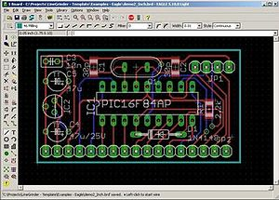
The Curse on the Tower of Babel（Reaching the Heaven）： A People that lost a common language for the construction of complex systems
High Coverage, Low Resolution
Multi-agent and System Dynamics
Focused on results and functions
Focus on Relations, Structures
Low Coverage, High Resolution

Slide 6


The Historical Context of Algebra of System (AoS)
With the Chinese Astronaut Mr. Yang, Reaching Earth Orbit in 2003,，it stimulated America in a strategic way.
NASA organized MIT and Boeing in a Land on Mars Design Competition
James, R. Hansen, Societal impact of Spaceflight, NASA History Division, 2007
Chapter 7, (The TaikonauT as Icon: the Cultural and Political Significance of Yang Liwei, China’s First Space Traveler)
President Kennedy, von Braun and Dr. Bob Seamans（NASA’s Associate Administrator)
Global Times: Story of China's first taikonaut's one day in space lights up internet, highlights country's space advancements

Slide 7



AoS: formalize the process of Decision-Making
The Challenge to Systems Engineering：
Hard Decisions：Political trade offs between Inter-domain knowledge
Lack of Precision：Insufficient or overwhelming Model complexity
When to reach a decisions：Decisions are either made pre-maturely or too late

Slide 8
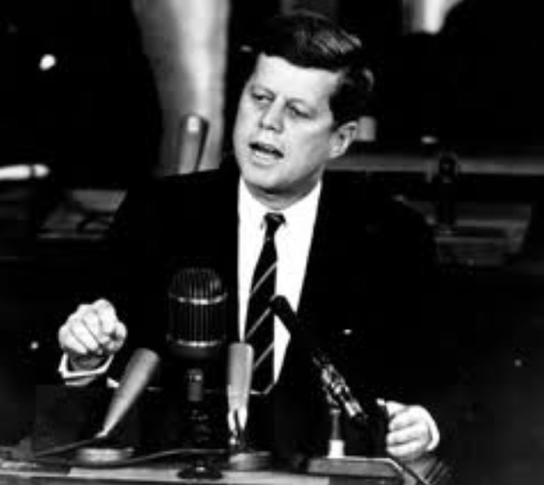
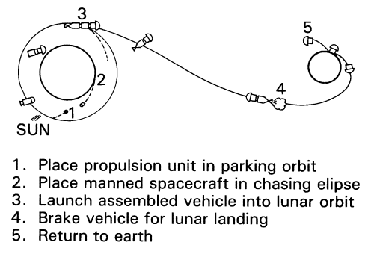
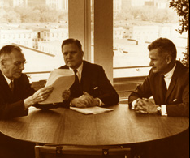
Inter-Disciplinary and Multi-Scale Decision
Send a man to the moon and get him back on earth safely before the end of this decade!
Technical Solutions and Implementation
Financial and Administrative Supports
President Kennedy Challenges NASA to Go to the Moon
Cash Flow Schedule
Inter-Departmental Negotiation and Collaboration
NASA History Site
NASA History Site

Slide 9




The Focus of Decision：Mission Complexity and Size of Rocket
Mechanical Structures of various Solutions
Direct Ascend/Descend
Lunar Orbit Rendezvous
The sizes of Rockets given different Solutions
Which way to the moon? Lunar Landing Techniques

Slide 10



Denoting and Representing the Solution Space
Maneuver-Based Motion Planning for
Nonlinear Systems With Symmetries
by Emilio Frazzoli et al., Dec. 2005
Acceleration | Motion Type
Constant | Repeatable Motion
Non-Constant | Finite Maneuver
Image courtesy: Prof. Edward Crawley
Finite State Machine Can be used to Represent Motion Archetypes

Slide 11






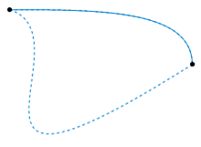
Networks of directed relations can express arithemtics, geometrical projections and data indexing
Arrow(Directed Relations)：“Universal Component” of Information Representation
Image excerpts from Lawever and Schanuel, Conceptual Mathematics: A first introduction to Categories, 2nd Edition, 2009

Slide 12
What is Algebra？What are Systems？
Algebra := <Operand Set, Operator Set>
Operand Set：Defines the boundary of algebraic operands，It can be seen as a Namespace。
Operator Set：Defines the rules of composition of operands，such as add, subtract, multiply, division。
Closure Property：All compositions by applying various operators remains in the Operand set。
System：The collection of inter-related elements, is called a system. (The collection includes the relations between elements。)
Algebra of Systems：A set of inter-relating operators(Functor) that relates/composes systems with above-mentioned closure property.
ID(Set) | Name(Set) | Data Type | Ordered parameters
0 | a | OBJECT | EMPTY
1 | b | OBJECT | EMPTY
2 | c | OBJECT | EMPTY
3 | d | OBJECT | EMPTY
4 | e | EDGE | (a,b)
5 | f | EDGE | (b,d)
6 | g | EDGE | (d,c)
7 | h | EDGE | (c,a)
8 | EMPTY | EDGE | (d,b)
𝛾 Functor
a
e
h
b
c
f
g
𝛼 Functor
d
The “Set Category” is denoted as ：Set

Slide 13

Methodology：Apply algebraic principle to ensure closure in data content
Algebra of Systems： Use the semantics of many sorted structure to represent objects and their interrelations in a system。
Namespaces：Participating Objects，Interacting Processes and structural relations in Network as “Name spaces”.
Representable Functors：Use three sets of algebraic operators to manipulate data content in（ <P,B,C> operand）, so that multi-level interactive consequences can be represented in concrete data formats.
Algebraic Domain | Operand Set | 算符集
System Domain（AoS） | < P, B, C > | <encd, enum, eval>
Property Domain （Properties, P） | {<key, value>*} (key value pairs) | < merge, substitute, interp, delete >
Logical Domain （Boolean Cond, B） | { assumption, assertion} (Boolean expressions) | < and, or, negate, interp>
Composition Domain （Composition, C） | <{Obj},{Proc} ,{pre},{post} > | < union, subtract>
Token
Every ”Token” includes《P, B, C》, a tuple containing three types of data
Pre-condition := {t < 5}
Pre-Condition: assumption
Post-Condition: assertion
Post-condition = True

Slide 14
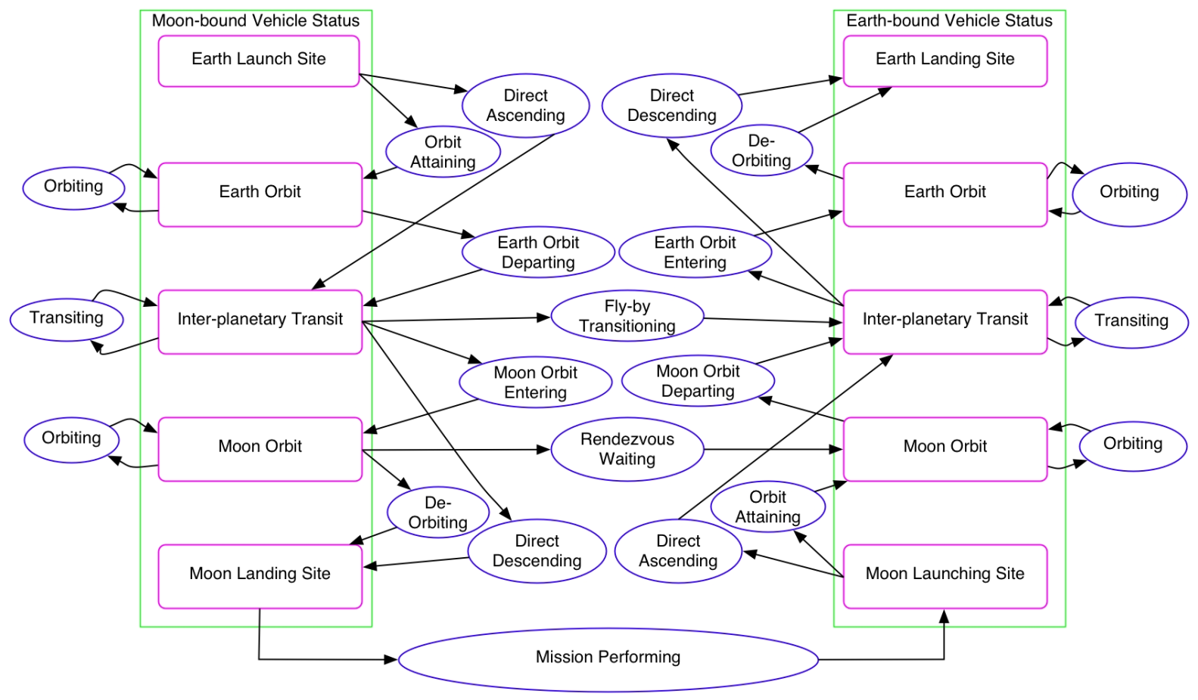
Domain-Specific Language Specification
Using a Bipartite Graph syntax to encode the space of solutions.
A
D
E
B
Pre-condition
A
B
C
assumption
Verb Phrases
C
Noun Phrases
assertion
Post-condition
Token
“Token” is a generic data structure，in Colored-Petri-Net literature, a token can incorporate distinguishable information content, in other words, it can be used to represent Non-Fungible Token (NFT) in discrete time dynamical systems.

Slide 15



Functional and Arithmetic calculation can be carried out in chasing the arrows
P1
P2
P3
Triggering token
Multiplication
t1
t2
t3
t1
t2
t3
P1
P2
P3
Addition
Outgoing arrows represent multiplication
Incoming arrows represent addition
Every ”Token” includes
《P, B, C》, three data types, recursively
The number of system solutions can
be methodically assessed based on enumerative combinatorics.

Slide 16
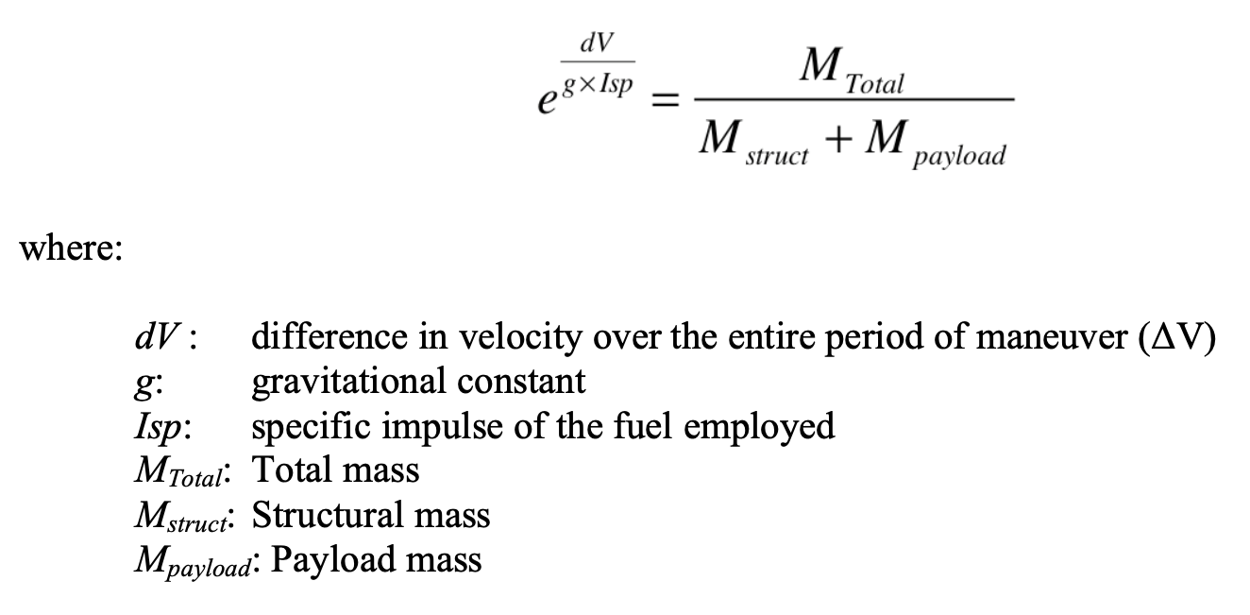
How to compute numerical values using arrows?
Total Mass of Rocket：M_{total}
One may use Rocket Equation:

Slide 17



“Named” Property Domain Specification： the textual representation of rewrite rules
Property Domain： representing key-value pairs in Backus-Naur Form
Namespace：PROP, EXPR, VAR, … as reserved words
Rewrite rules：merge, substitute, delete, interp as operators。
Key=Namespace
Value=Rewrite rules
Set theoretic operations
Arithmetic rules
According to Lambda Calculus’s universal algebraic expressive power，Function calls, equational reasoning/simplification, arithmetic assignments，can all be attained through applying Rewrite Rules.

Slide 18



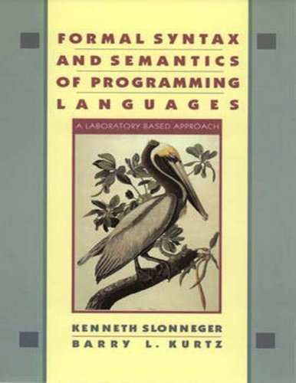
Compute Arithmetic Expressions using Arrows (Directed Relations)
Avoid loopy structures
It is necessary to detect potential loopy references in the interacting tokens, and handle loopy references in ways to avoid infinite recursion.
Fixedpoint Semantics
Slonneger, Kenneth; Kurtz, Barry L. (1995). Formal Syntax and Semantics of Programming Languages:A Laboratory Based Approach, Chapter 10,
As long as the names of functions are unique, it can be un-mistakenly triggered into the abstract syntax tree.
Abstract syntax tree can be thought of as a special case of Partially Ordered Set.

Slide 19


The Implementation of a system solution generator（in year 2004）
System Specifications of each solution is represented in semantics that are meaningful to relevant stakeholders.
Encoding, Enumerating, Evaluating are the meta-operators of AoS.
Encode in Namespaces
Enumerate Exhaustively
Evaluate in proper semantics
(Hashtable, Associative Array)
(BDD, SAT)
(Symbolic Math, Function Evaluation)
Trace Semantics
(Reachability)
Encode
Possibility
Space
Domain-Specific
Key-Value Pairs
OPN-IDE can incorporate many styles of data representation to accommodate inter-domain communication.
The red curve represents the Pareto Front as an “optimal solution” filtering mechanism.

Slide 20


(Live software demo)
Exploring the Solution Space with Encode, Enum, and Evaluate
DSL:Domain Specific Language
Representing Mission Structures
Defines
Solution space of interest
Evaluated and Optimizing
Enumerate Instances of Solutions
Introductory material to enumerative combinatorics

Slide 21
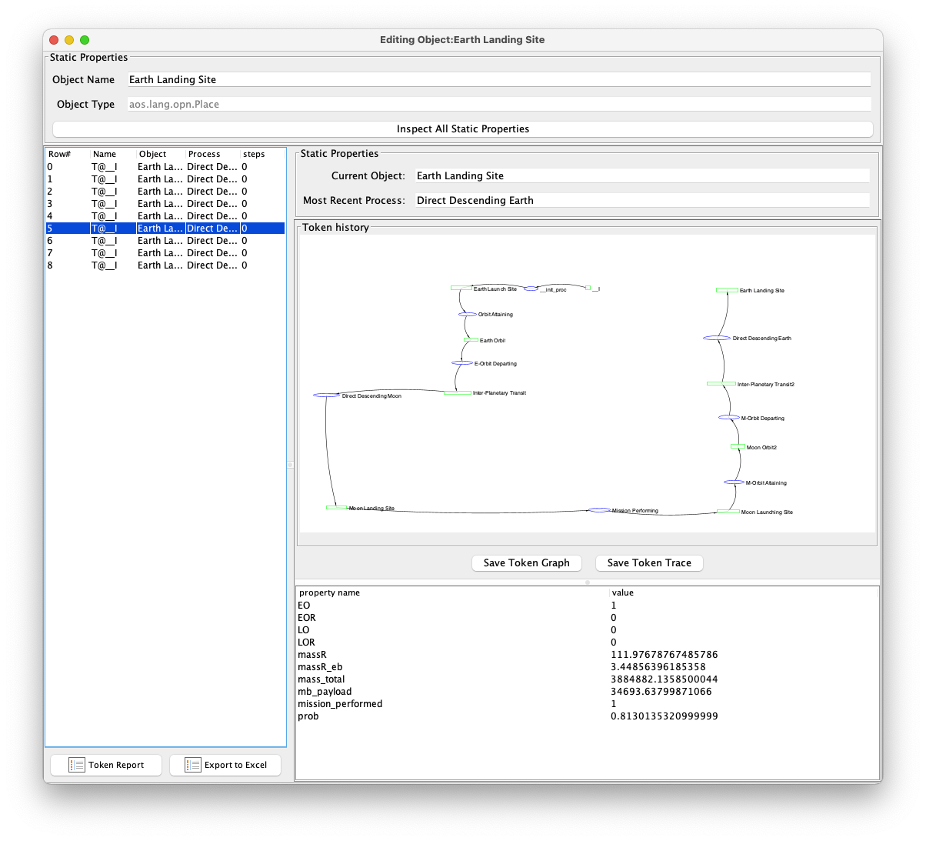
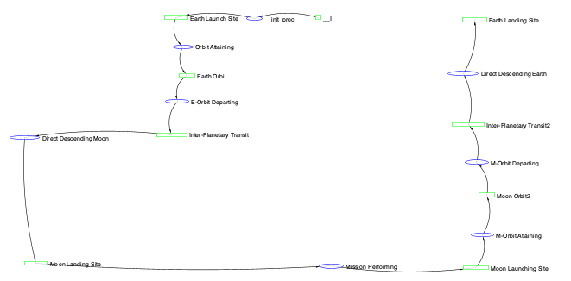
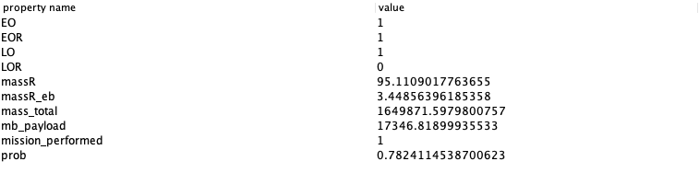
The Semantics of Key Value Pairs is a Declarative Language (XML/JSON/YAML)
Values=Rewrite rules of a localized solution space
Keys=Namespace
Trace Semantics
Keys=Namespace
Values=Rewrite rules
Domain-Specific
Key-Value Pairs

Slide 22


Algebraic Closure of Model Space
The Boundary of AoS：Many computations can be expressed in terms of network Reachability，
Reachability：Petri Net can be used to represent a very large class of concurrent and dynamical discrete systems.
Generative Structure：Encode, Enumerate, Evaluate as the 3E language operators as a whole can be used to control the size of enumerative efforts.
Algebraic Meta Language：All Domain Specific Language could be defined using the 3E approach.
Closure of Model Space
Eval
Encd
All computation in AoS will produce elements that
are still in the domain of AoS.
Enum

Slide 23

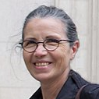



The THREE Necessary and Sufficient Conditions of Decision Making (The Main Thesis of Abstract Interpretation)
Soundness
Precision
Termination
Soundness: All provable truth are true;
Completeness: All truth are provable;
Precise semantics: Avoid False Positive/Negative.
Terminable: The program of interest eventually stops;
Bounded Term.: The said program stops given a bound;
The propositions(assumptions and assertions)
Are coherent with final outcome
The represented information is shown in notations that are sufficiently accurate for decision making
Make Decision within Finite Resources
Notes:
(notes) add hyperlinks with definitions
Soundness: A Sound statement is a true statement whose composed sub-statements all accountably true, and the overall constructed statement also can be assessed to be true.
The degree of a statement to be sound is its Soundness assessment.
Precision (The result has a outer boundary)
Termination (It will come to completion)

Slide 24



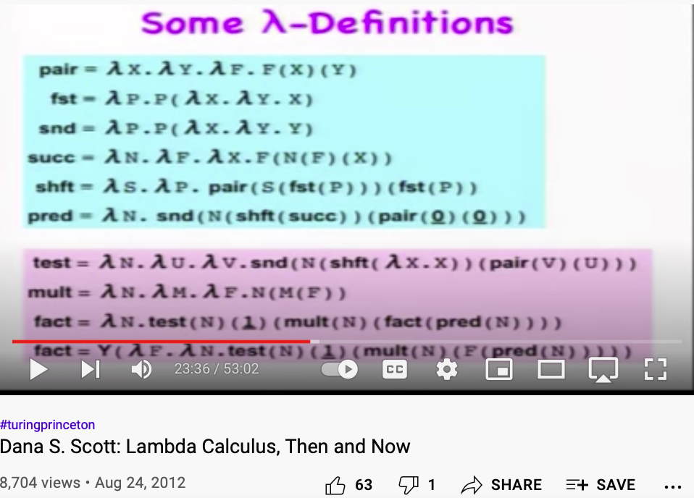

All Data Types can be represented by Partially Ordered Set (POSet)
Universality
Denotational/Mathematical Semantics invented
by Dana Scott
have elevated methods of computation
from arts to science.
lowest upper bound (lub)
Join/Top
Axiom1: A Data Type is a Partially Ordered Set
Dana Scott: 1976 Turing Awardee
Image Source: Wikipedia
greatest lower bound (glb)
Meet/Bottom
Lattice is a special case of Partially Ordered Sets
Lambda Calculus, Then and Now

Slide 25



The Influential Regions of Present Data can be bounded in Lattices
Future Impactful Region
Boundary of Physical Causal Relations
Boundary of Physical Causal Relations
Time
Axis
Present Data
Image Source:
Wikipedia on Light Cone
Boundary of Physical Causal Relations
Boundary of Physical causal relations
Past Influential Regions
Spatial Axis

Slide 26
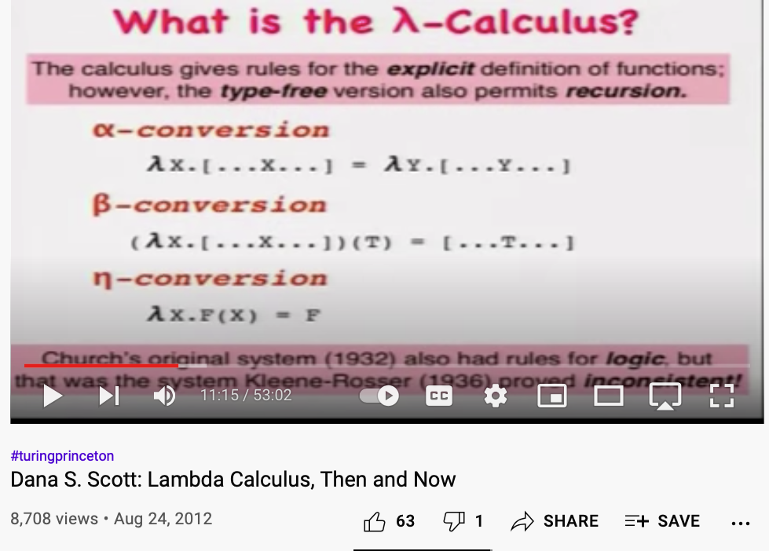
The Closure Property of POSet/Lattice as a Language with Universal Expressiveness
Lattice must have a Top/Bottom pair
Properties of POSet | Semantics
Names as Types | Type Calculus
Elements jave unique identity | Non-Fungibility
Coutability | Countable
Inclusion or order | Partial Order (Inclusion)
Path structures | Reachability
Top
Rewrite Rule
Substitution
Bottom
Placeholder
All computable functions can be represented as Lambda expressions
Terminal
Primitive Function（Reserved Word）
𝝺x.(…x…)
𝝺y.(…y…)
𝝺x.(…x…)(T)
(…T…)
f(Expression)
(Evaluated Expression)
Watch from 666 seconc and ending at1080 second

Slide 27






Formal Systems Design Methods and Tools
He applied Partially Ordered Set to present a methodology to reason about distributed and concurrent system.
He also created TLA+ (Temporal Logic in Action).
Automatically Enumerate Abstract Specification.
POSet
Leslie Lamport：2013 Turing Awardee
https://lamport.azurewebsites.net/tla/amazon-excerpt.html

Slide 28

Formal Representation of System Correctness
Abstract Specification
lowest upper bound (lub)
Join
Correctness Assertion = Safety ^ Liveness
Solution Space
Safety
Liveness
Domain Spec Lang
Defines a localized
Namespace
To denote the inter-relations of subsystems
Liveness
Some good things happens
Safety
No bad things happen
Correct
Correctnes
Meet
Verify Safety and Liveness
greatest lower bound (glb)
Boundary Conditions
The typical Venn diagram
semantics of Intersection and union of solution space.
Intersection and unions expressed in POSet

Slide 29



System Modeling in an Iterative Search Process in the Solution Space （fixed point semantic formalize model interpolation）
Functor：A mechanism for mapping systems’ internal structures.
Abstract Interpretation With Professor Patrick Cousot
| Lecture Series on AI #11 | J.P. Morgan
𝛾：Functor that maps to the Concrete Domain
Correct System Behavior
Correct
System
Model
Safety
Liveness
Safety
Liveness
The Galois Correspondence
In Abstract Interpretation Literature
𝛼：Functor that maps to the Absrtact Domain
Concrete System
Abstract Model
Image source: A Galois Connection Calculus for Abstract Interpretation by Patrick Cousot

Slide 30
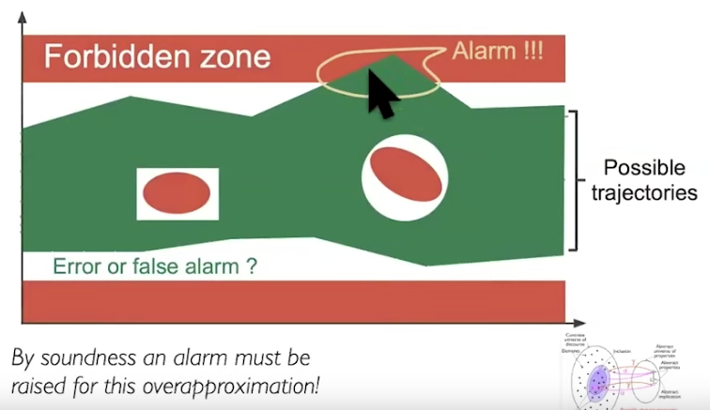
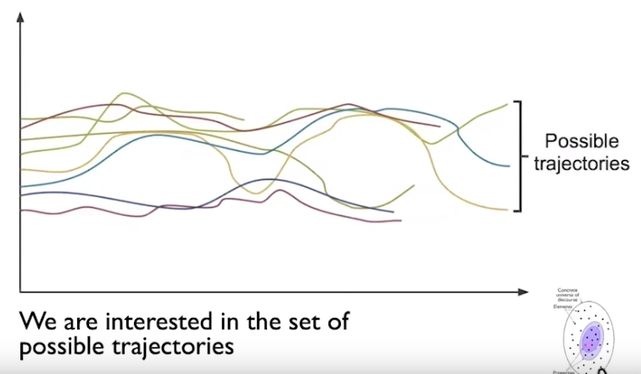
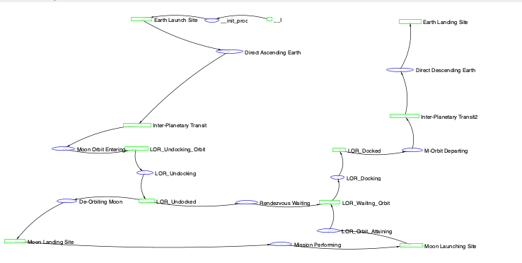
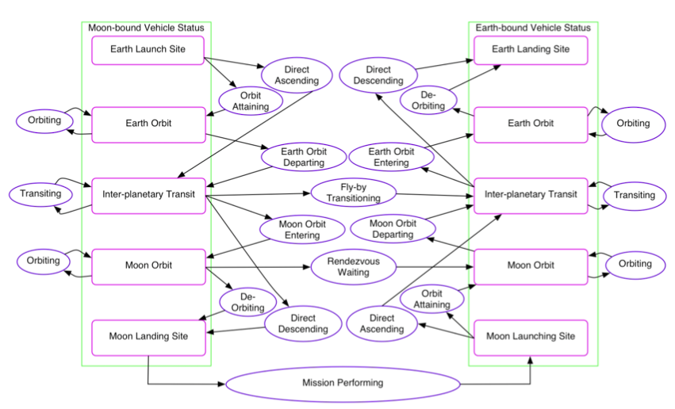
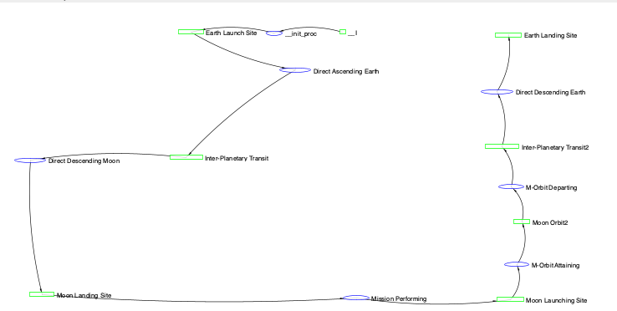
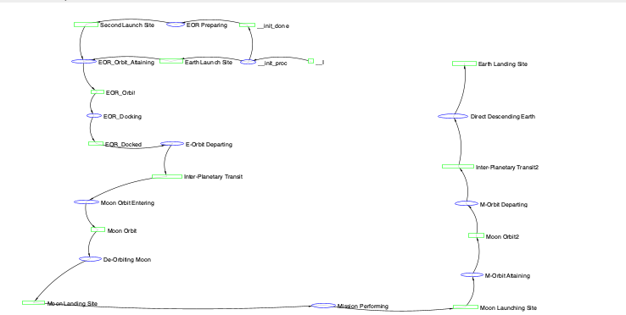
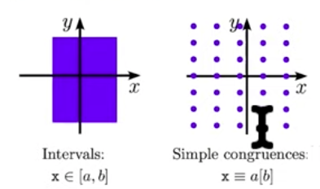


All Domains of Decision Problems can be converted into POSet
Application Domain
Domain-Specific Semantics
Data Rendering Formats
POSet
$$∅$$
Partial Ordering Relation：High Probability of Success ⋀ Low Total Mass
Best
Decision of Choice
EO+LOR
EO+LO
EOR+LOR
EOR
EOR+LO
LOR
Direct
LO
EO
$$Best$$
$$∅$$
Collecting Semantics
Actual Expense<Budgeted Expense
Partial Ordering Relations：mission execution sequence
Optimal Routing/
Mission Planning
Reachability Semantics
Partial Ordering Relations：Project Deadline and Cash Expense Schedule
Land on the moon before 1970，
At least one man safely come back from moon surface
Financial Accounting
T< 1970
Actual Expense<Budgeted Expense
Landing on the moon
Interval Semantics
Correctness

Slide 31











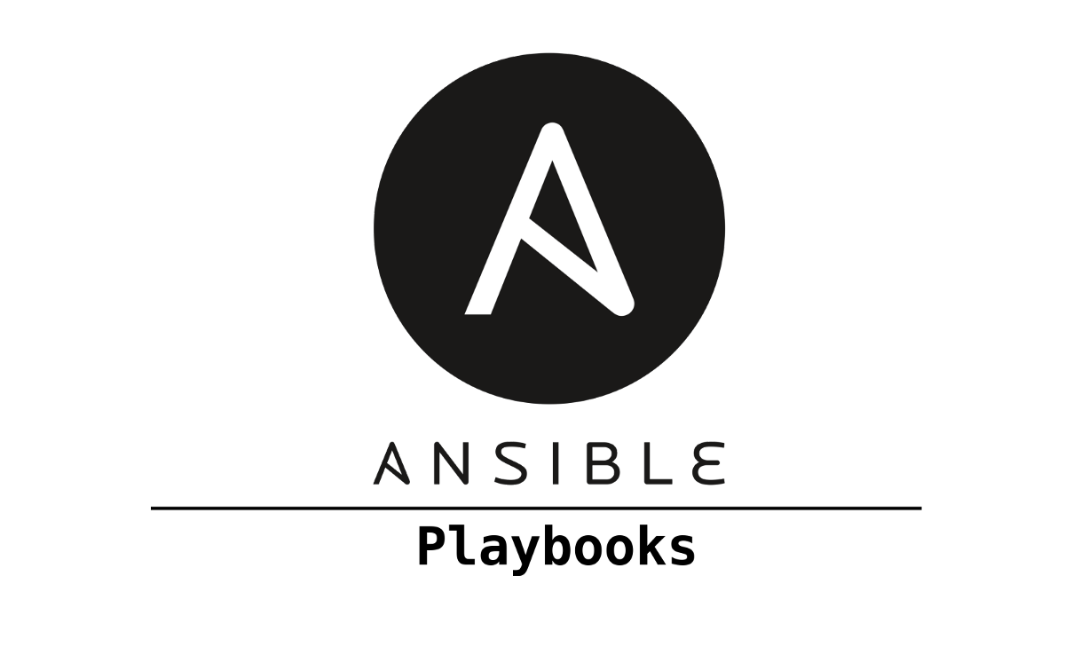


AoS and DevOps
Algebraic Closure：
Applied to Inter-Disciplinary, Multi-Scale Technology
Development Projects in PKC.
Data presented in Page Category
Knowledge Accumulated over Iterations of Computational efforts
Eval
Encd
Data managed by Service Category
Data stored in File Category
Distinct Solution Instances
Abstract Solution Set
Enum

Slide 32

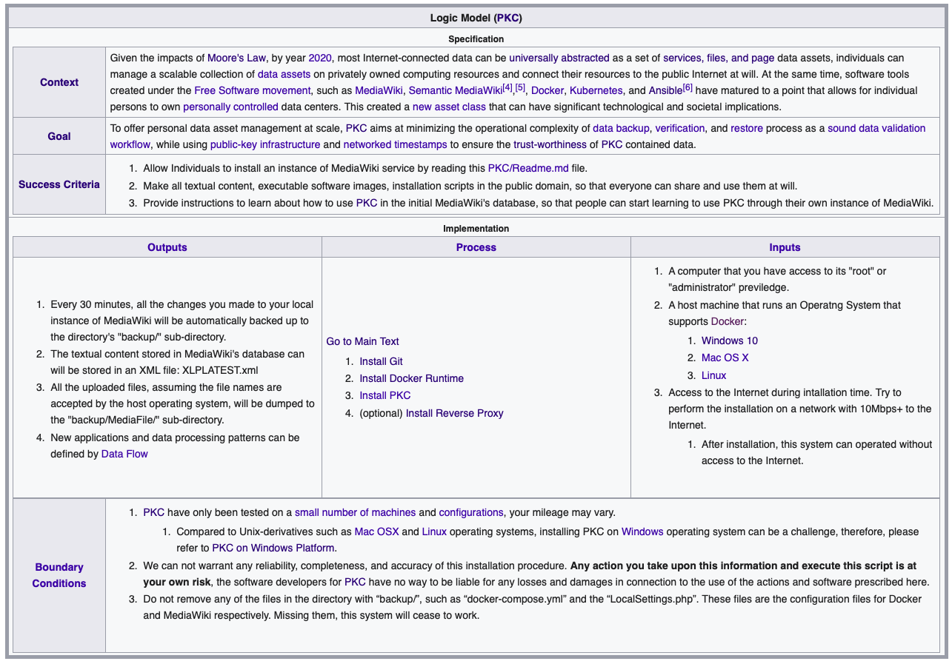
From Logic Model to Programmable Web Page Interfaces
Personal
Knowledge
Container

Slide 33
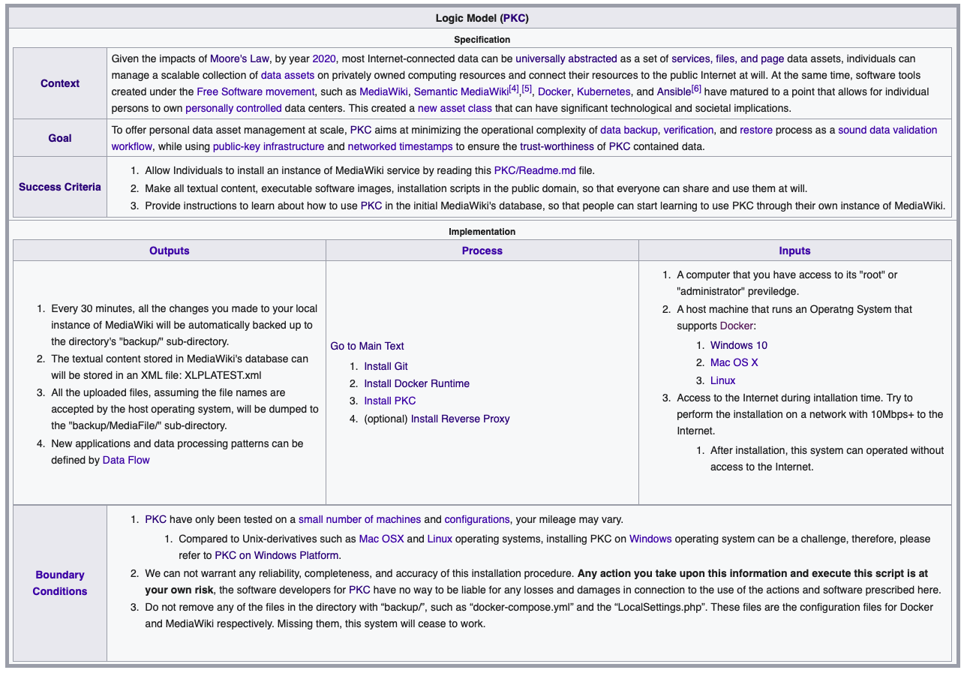
The Over Arching Process of running Projects in AoS
Uni-verse
=Convergence ∨ Diverse
Spatial and Temporal Boundary of Project
Adjusting Context
Declare Project Goals (Encd)
Abstract Specification
Project Goals
(Objectives)
Assesing Liveness
Project Liveness Contract
Divergence
Generating Solution Instances (Enum)
元关系
Convergence
Concrete Implementation
Output
Key Results
Process
Inputs
Verifying System Safety Boundary
Meta-verse
=Convergence ∧ Divergence
Safety Criteria Statement

Slide 34







The Three Types of Data Assets in Namespace or Set Categories
File
Page
Service
Abstract Specification
Personal
Knowledge
Container
Concrete Data Content

Slide 35




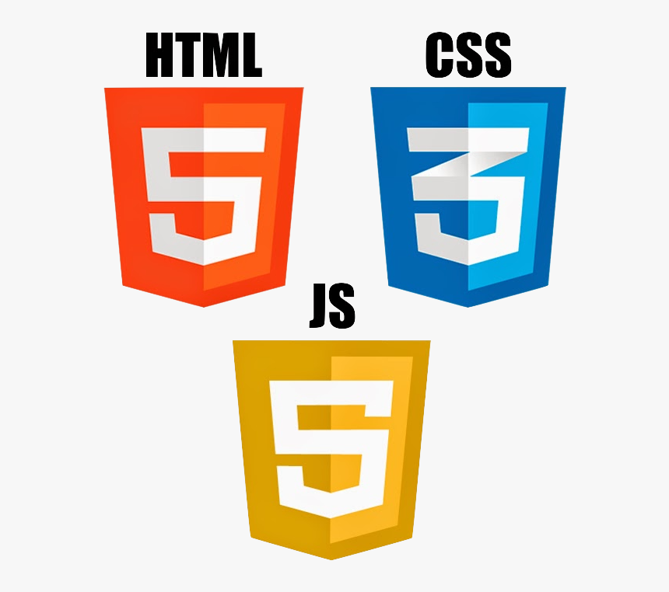


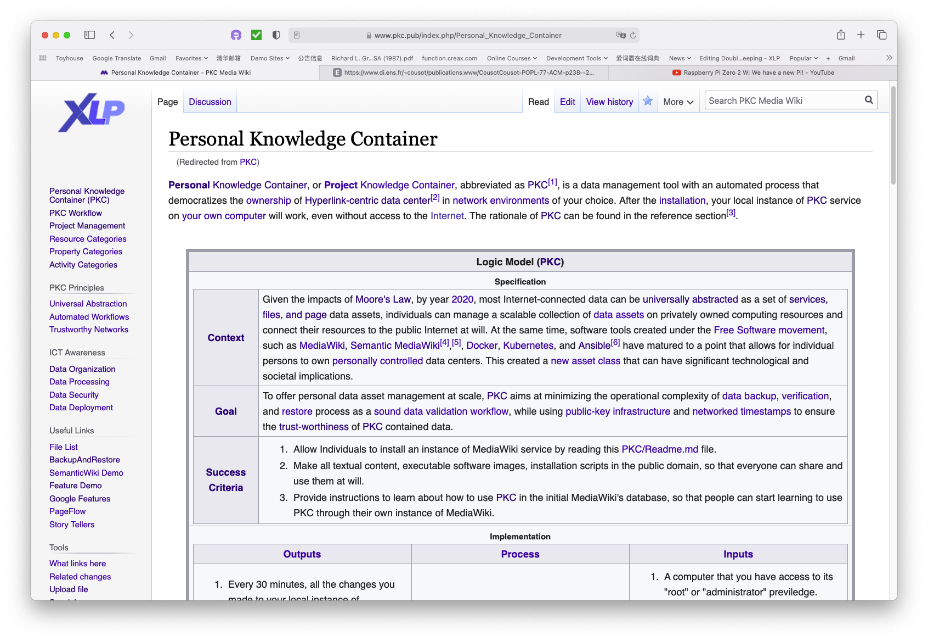











Data Interoperability comes from Symmetry and Closure
Precision
Users will see data in formats that are suitable for making decisions in human-friendly interfaces.
Page Namespaces
Encoding Namespaces
Industrial Scale Data Inter-operability Standards
Soundness
Data security and trust-worthiness is ensure through version control and distributed witnessing mechanisms.
Terminability
Deploy appropriate amount of computing resources to ensure that decision processes can terminate in time.
Service Namespaces
File Namespaces
Data Content to be presented in
Concrete devices/terminals
Various IoT and
Social networks

Slide 36

Representable Functor：A mathematical instrument to set up Namespaces wikipedia: Representable Functor
Functor is the formal instrument to map multiple data types
All Inter-domain semantics can be translated through the Set Category.
Verifying safety and liveness
All names are accountable in a well-defined Set
Algebraically closed Namespace
Validate Concrete Data
Specify Abstract Goals
Domain Specific Data
Project Goals
Concrete Implementation
Abstract Specification
AoS uses Functor to define DSL, that can converge on a small set of data types。
Please read A General Theory of Natural Equivalence to learn more about Functor

Slide 37
Contributions of AoS （Algebraically represent and reason about decisions across local and global system concerns）
AoS offered an Inter-Disciplinary, Multi-Scale algebraic system modeling method to enable data interoperability in any abstract systems.：
Sound Method：Soundness is guaranteed by closure properties of automated model constructions
Appropriate Precisions：Define DSL according to precision requirements
Terminable Exhaustion: Every search space is bounded in finite space。
Real System
Real System
System Knowledge
System Knowledge
Systems Engineering
Contribution
Systems Engineering
Interoperability
AoS
Personal
Knowledge
Container
Abstract Systems
Namespaces

Slide 38
Governing System Complexity must surpass the three-entangled Requirements
The Assumptions/Assertions of the System must be consistent with real world results
Soundness
Based on Algebraic Closure, all models are generated using axiomatic rules, which allows the composed solutions to be testable according to the rules，therefore satisfy “soundness”。
Concrete DSL Data Representation
Galois Connection
Abstract Properties
Termination
Precision
Make Decisions within bounded Computing Resources
The DSL defined using AoS can be customized to incorporate adequate precision.
All domains of data content must be representable in Partially Ordered set (POSet), which allows proper precisions to be systematically approximated based on POSet rules。
POSets can be organized to avoid infinitely sized structures，in most cases, can guarantee terminability given modern computing tools.
Notes:
(notes) add hyperlinks with definitions
Soundness: A Sound statement is a true statement whose composed sub-statements all accountably true, and the overall constructed statement also can be assessed to be true.
The degree of a statement to be sound is its Soundness assessment.
Precision (The result has a outer boundary)
Termination (It will come to completion)

Slide 39

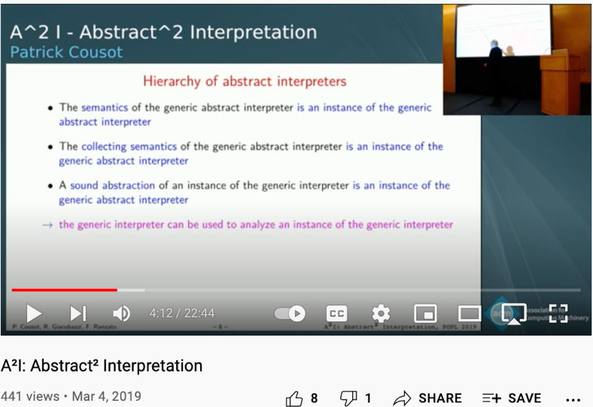
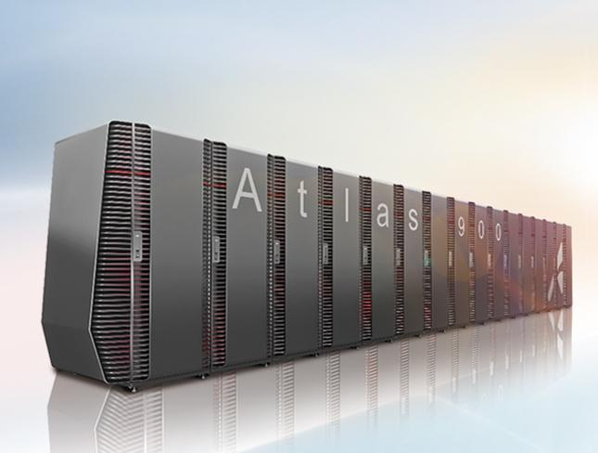
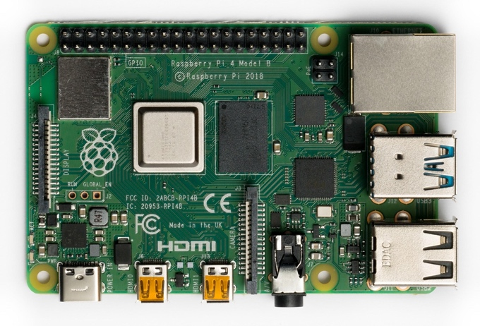
Next Step： Incorporate AoS into PKC
Adopt Cloud Native architecture for hardware and software solutions，Use AoS to create a Standardized Workflow that will run on Edge and super computing devices.
Based on Abstract² Interpretation（A²I）/Meta Abstract Interpreter to complete the computing kernel of AoS。
Create training courses to enable more people to use AoS and PKC.
Youtube Link
Prof. Cousot and Koo in 2005

Slide 40
References
Han, Feng; Zhang, Kai (Oct 2021). "Nonlocal properties of quantum mechanics and the concept of entropy". To be published. 9 pages.
Lamport, Leslie (2020). Specifying Systems: The TLA+ Language and Tools for Hardware and Software Engineers. Microsoft Research.
周(Zhou）, 子衡(Ziheng) (May 1, 2017). 账户-新经济与新金融之路. 社会科学文献出版社. ISBN 9787520104975.
Fong, Brendon (2016). The Algebra of Open and Interconnected Systems (PDF) (Ph.D.), University of Oxford
Koo, Hsueh-Yung Benjamin; Simmons, Willard; Crawley, Edward (May 2009). "Algebra of Systems: A Metalanguage for Model Synthesis and Evaluation" (PDF). IEEE TRANSACTIONS ON SYSTEMS, MAN, AND CYBERNETICS.
Lawvere, William; Schanuel, Stephen (January 8, 2009). Conceptual Mathematics_A First Introduction to Categories (2nd ed.) Cambridge University Press.
Cardone, Felice; Hindley, J. Roger (2006). History of Lambda-calculus and Combinatory Logic (PDF), Publisher Elsevier.
Frazzoli, Emilio; Dahleh, Munther; Feron, Eric (December 2005). "Maneuver-Based Motion Planning for Nonlinear Systems With Symmetries" (PDF). IEEE TRANSACTIONS ON ROBOTICS (VOL. 21, NO. 6 ed.). IEEE: 1077-1091.
Koo, Hsueh-Yung Benjamin (31 Jan 2005). A Meta-language for Systems Architecting (PDF) (Ph.D.), MIT
Dori, Dov (2002). Object-Process Methodology:A Holistic Systems Paradigm. Springer Mac, LLC. ISBN 978-3-540-65471-1.
Slonneger, Kenneth; Kurtz, Barry L. (1995). Formal Syntax and Semantics of Programming Languages:A Laboratory Based Approach. local page: Addison-Wesley. ISBN 0-201-65697-3.
Cousot, Patrick; Cousot, Radhia (1977). Abstract interpretation: a unified lattice model for static analysis of programs by construction or approximation of fixpoints (PDF). 4th POPL. local page: ACM Press. p. 238-252.
Eilenberg, Samuel; MacLane, Saunders. "General Theory of Natural Equivalences". Transactions of the American Mathematical Society (Vol. 58, No. 2 (Sep., 1945), ed.). American Mathematical Society: 231-294.

Slide 41
Acknowledgement:
Muhammad Haviz、余正军、刘喜华、Grace Koo、Michael Xia、周硕彦、王丰
Who provided great feedback to this slide set.

